Slide 1
SSH Foo
KW-LUG Presentation
Epoch 1543838400
jasoneckert.net

Slide 2
SSH Kung Fu
KW-LUG Presentation
Epoch 1543838400
jasoneckert.net

Slide 3
SSH Fu
KW-LUG Presentation
Epoch 1543838400
jasoneckert.net

Slide 4
SSH Foo
KW-LUG Presentation
Epoch 1543838400
jasoneckert.net

Slide 5
Crypto Basics
Symmetric crypto (e.g. AES/Blowfish/RC4):
Fast for encrypting payloads of data
Key negotiation across a network sucks
Clients usually generate a symkey and encrypt it asymmetrically to get it to a server

Slide 6
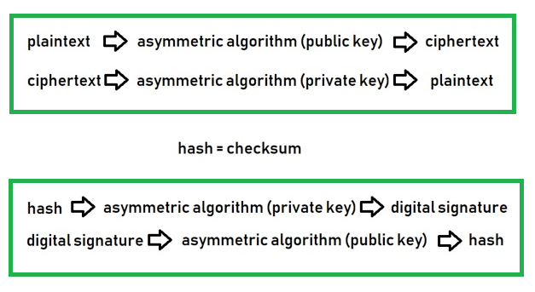
Crypto Basics
Asymmetric crypto (e.g. RSA/DSA/ECC):

Slide 7
SSH Basics
Encrypted telnet but without Star Wars
Uses symmetric encryption for all payload data
Uses asymmetric encryption to protect sym key generated by the SSH client

Slide 8
SSH Basics
Symmetric encryption controlled by client
/etc/ssh/ssh_config
Ciphers (usually AES*)
Asymmetric encryption controlled by server (the host keys):
/etc/ssh/sshd_config
HostKey /etc/ssh/ssh_host_rsa_key (& .pub)
HostKey /etc/ssh/ssh_host_ecdsa_key (& .pub)
HostKey /etc/ssh/ssh_host_ed25519_key (& .pub)
~/.ssh/known_hosts

Slide 9
SSH User Keys
You can also create asymmetric keys for your local user account and add these keys to each server you manage to avoid passwords
ssh-keygen
***Do you want to protect private key with passphrase? You’ll need it each time the private key is used unless you want to load the ssh-agent
cat ~/.ssh/id_rsa
cat ~/.ssh/id_rsa.pub
ssh-copy-id -i root@server1
ssh root@server1 (look ma, no password!)
Notes:
PermitRootLogins without-password

Slide 10
SSH User Keys
Many systems prevent root SSH in sshd_config (must connect as bob and su/sudo):
PermitRootLogins yes/no/without-password
If you want to omit the username for each host, you can use host-specific options on your SSH client to specify a default user:
cat ~/.ssh/config
Host server1
User admin
Host server2
User bob
Notes:
PasswordAuthentication no (requires SSH keys for all connections!)

Slide 11
Copying Files
Copy remote /root/lala file (on server1) to local /var directory
ssh root@server1 cat /root/lala > /var/sample
scp root@server1:/root/lala /var
Copy the local /root/lala file to /var directory on remote computer (appserver)
ssh root@server1 cat </root/lala ">" /var/lala
scp /root/lala root@server1:/var

Slide 12
Copying Files
Can also use piping
dd if=/root/lala | ssh -C user@host dd of=/var/lala
Works for anything, really
dd if=/dev/tty5 | ssh -C user@host dd of=/dev/tty2

Slide 13
Tunneling
Tunneling X.org (requires xauth)
ssh –X root@server1
gnome-control-center
Tunneling other stuff (e.g. VNC)
Local tunneling – e.g. forward local traffic on port 5999 to server1 on port 5900 as bob.
ssh -L 5999:localhost:5900 bob@server1
After this, you can start a VNC viewer and connect to localhost:5999 to access the VNC server running on port 5900 on server1 through an SSH tunnel)
Notes:
Xauth is installed by default on workstation installs, but you may have to add it to a server install.

Slide 14
Tunneling
Remote tunneling – e.g. bob on client1 can start a VNC viewer and connect to server1:5999 in order to access the VNC server running on port 5900 on server1 (your server) via SSH.
ssh -R 5999:server1:5900 bob@client1

Slide 15
Tunneling
Evading firewall restrictions
ssh homeserver –L 443:lala.com:443
cat /etc/hosts (127.0.0.1 lala.com)
apachectl stop
curl https://lala.com

Slide 16
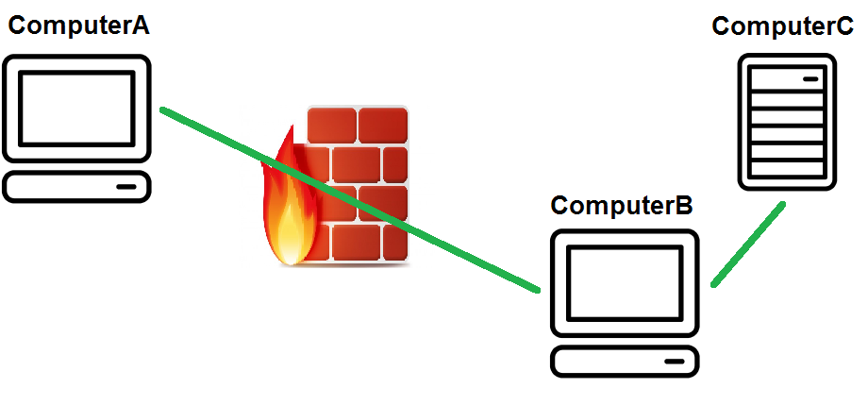
Tunneling
General format (you are computerA):
ssh computerB –L 443:computerC:443

Slide 17
Tunneling
Can also tell SSH to do SOCKS5 proxy forwarding to a home server to evade a firewall too:
ssh -D 8080 homeserver
Set Chrome/Firefox proxy address to localhost:8080
DNS requests are not part of this (you can tunnel DNS through a SOCKS5 proxy with other software like DNSCrypt)
Problems?
grep Forwarding /etc/ssh/sshd_config
X11Forwarding no
AllowTcpForwarding no

Slide 18
SSHFS (NFS is sooo yesterday)
Access remote / filesystem on server1 over SSH session mounted to local /mnt directory:
dnf install sshfs
sshfs root@server1:/ /mnt
ls /mnt
rm –Rf /mnt/* (--no-preserve-root bypassed)

