Slide 1
Intro to WSL
KW-LUG Presentation
Epoch 1546905600
jasoneckert.net

Slide 2
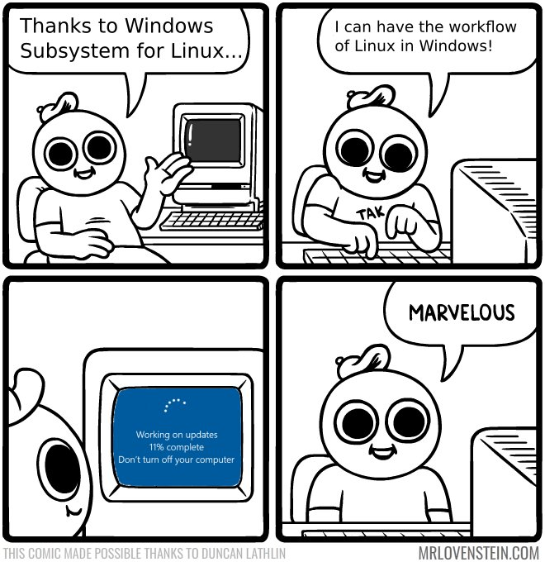

Slide 3
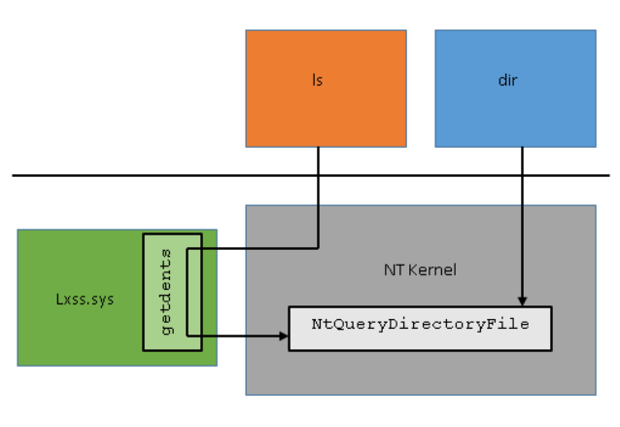
What is WSL?
It’s a kernel interface (lxcore/lxss) that allows 64-bit Linux binaries to run on a Win10/2019 kernel:

Slide 4
What is WSL?
Add a distro userland (everything else except the Linux kernel), and you can run Linux distros natively on a Windows kernel
You can start/access the Linux distro via a command (e.g. kali.exe)
You can install multiple distros
Primarily designed to support developers
Microsoft is actively changing it all the time

Slide 5
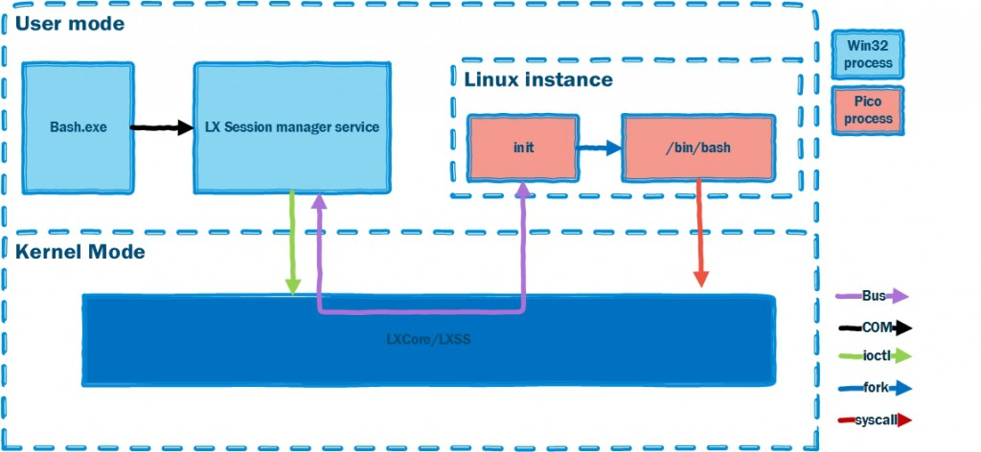
Interested in the architecture?
https://blogs.msdn.microsoft.com/wsl/2016/04/22/windows-subsystem-for-linux-overview/

Slide 6
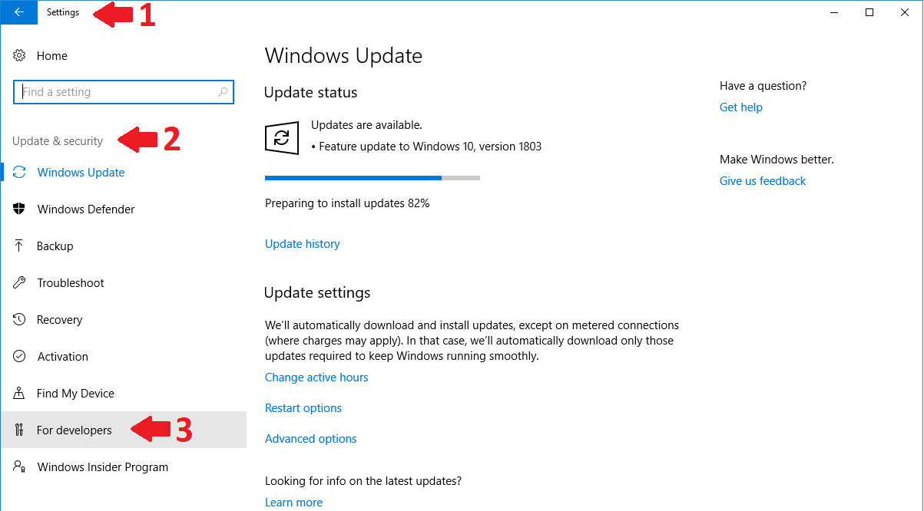
How do I install it?

Slide 7
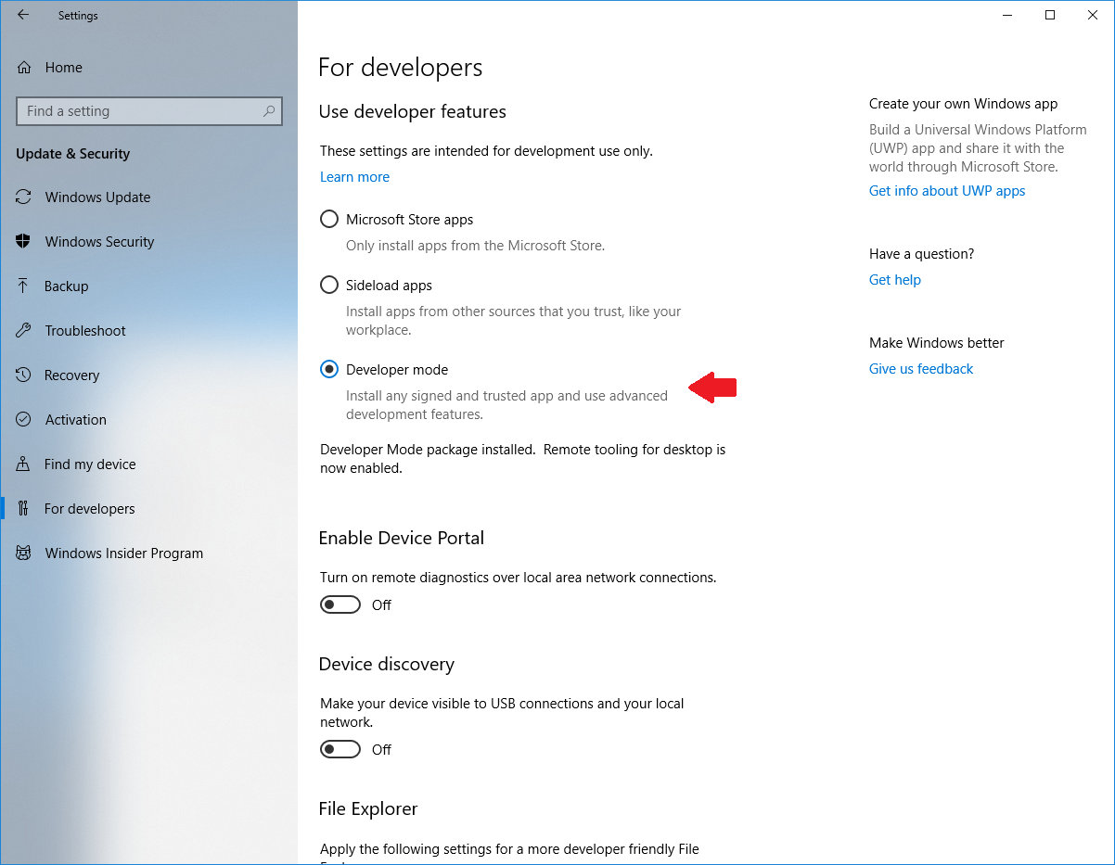

Slide 8
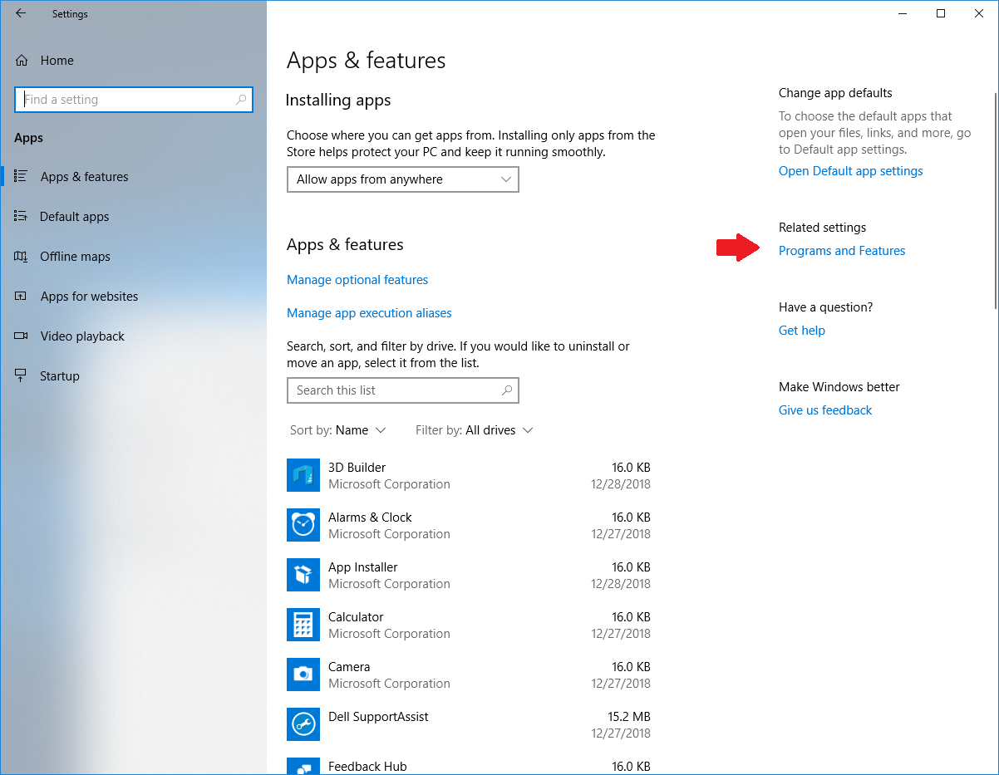

Slide 9
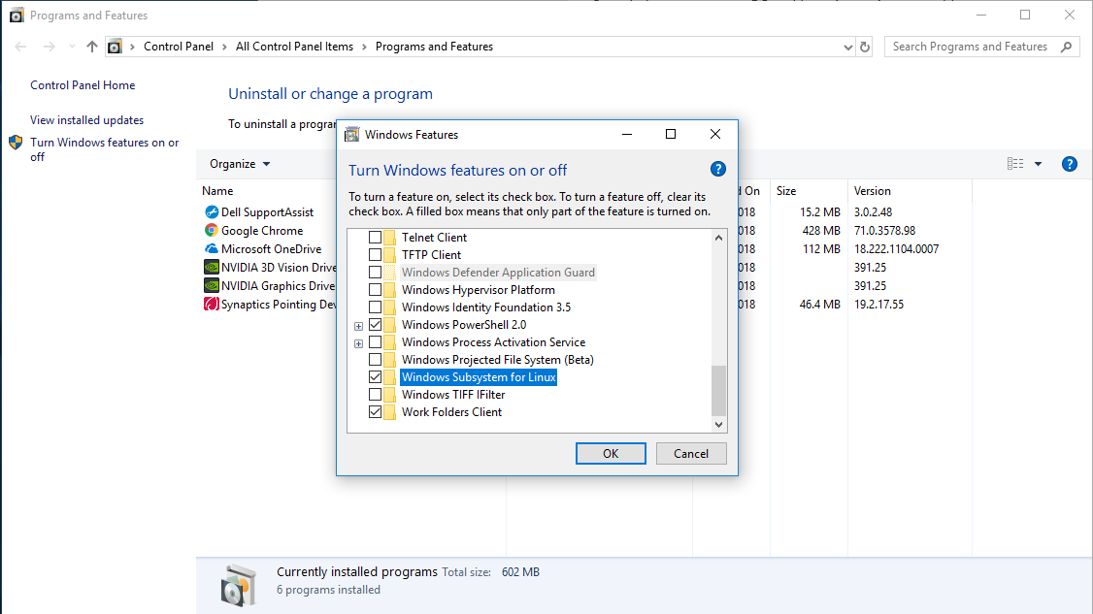

Slide 10
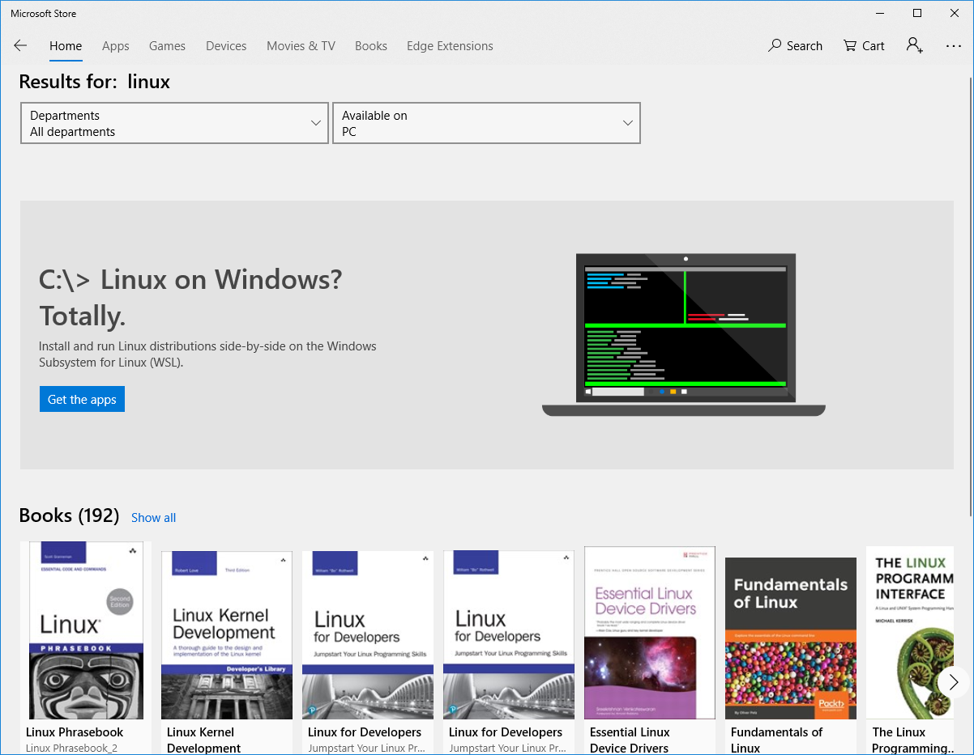

Slide 11
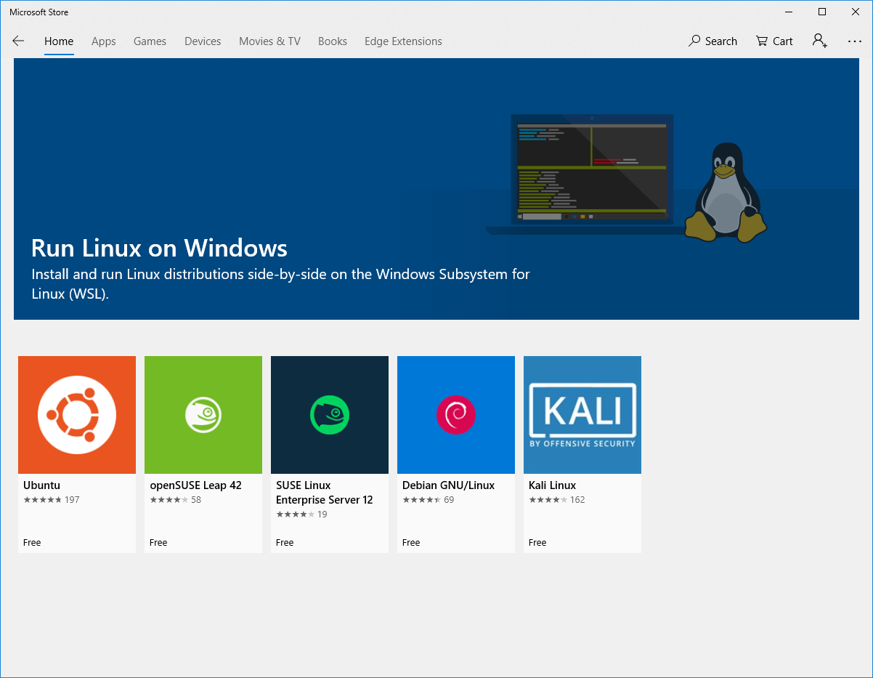
Notes:
Kali = 177MB download

Slide 14
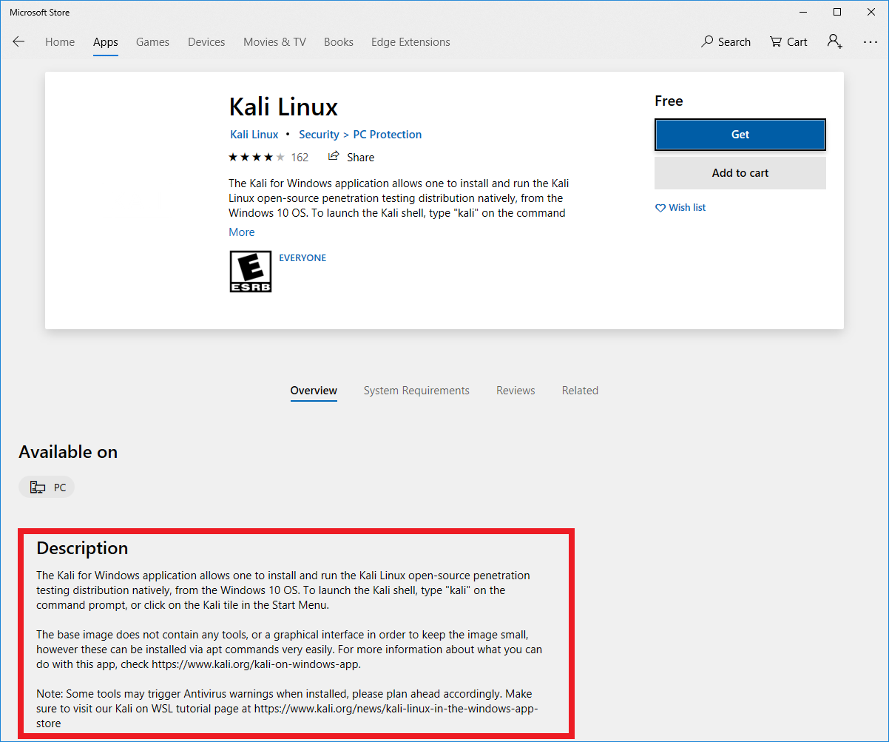

Slide 15
Finish the install
Click icon on Start, or
ubuntu.exe
opensuse-42.exe
sles-12.exe
debian.exe
kali.exe

Slide 16
What do I do now?
After installation
sudo passwd root
su –
apt-get update
wget https://kali.sh/xfce4.sh && sh xfce.sh
/etc/init.d/xrdp start (connect to localhost:3390)
apt install metasploit-framework
apt install ssh
apt install xbill
apt install apache2 (or whole LAMP stack)
apachectl start (connect to localhost:80)
ls /mnt/c
Notes:
KaliLinux.* under Packages is 2.4GB for me (because I have X.org, etc.)

Slide 17
What do I do now?
Paths (add exception in AV for first path):
C:\Users\name\AppData\Local\Packages\KaliLinux.*\
C:\Users\name\AppData\Local\Packages\KaliLinux.*\LocalState\rootfs
This is VolFs
Copying to it from Windows is flakey
Accessing Windows from VolFs is not flakey
(use symlinks to access Windows dev content via /mnt/c)
C:\Users\name\AppData\Local\Microsoft\WindowsApps\KaliLinux.*\kali.exe
Notes:
KaliLinux.* under Packages is 2.4GB for me (because I have X.org, etc.)

Slide 18
Final thoughts
Designed for developers who don’t want to mess with VMs
Many, many limitations (nmap?, wireshark?)
Not bad for an admin station (ssh, python, etc.)
Can be used to obtain ssh access to Windows via sshd (openssh-server)
Can be used to look cool (look ma, no VMs!)
Notes:
KaliLinux.* under Packages is 2.4GB for me (because I have X.org, etc.)

