Slide 1
vi & vim Basics
jasoneckert.net

Slide 2
Agenda
Intro
Why should I bother?
vi/vim Sur-vi-val Skills
More vi/vim stuff
What are your favourite vi/vim tricks?

Slide 3
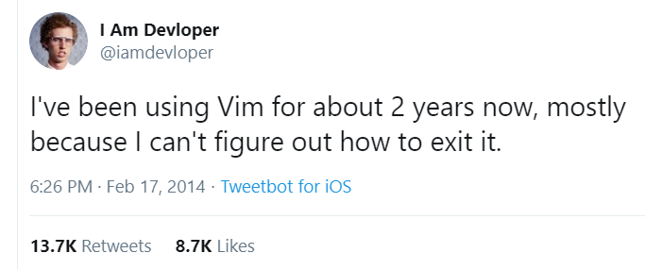
Intro
ed (1969) → ex / vi (1976) → vim (1991)
vim = vi + extras
May look intimidating at first…
Notes:
Ed (line-based) → ex (visual ed with vi being the visual mode, Bill Joy 1976) → vim (Bram Moolenaar 1991)
vim = vi + extras (ext regex, plugins, color language labels, etc.)

Slide 4
Why should I bother?
It’s very fast for anything, easily addictive
Powerful (800+ built-in functions)
Lots of plugins & customization ability
Short learning curve (basics = 1 day)
Found standard on most distros
A vi-able skill for any Linux admin, user or developer
Notes:
Ed (line-based) → ex (visual ed with vi being the visual mode, Bill Joy 1976) → vim (Bram Moolenaar 1991)
vim = vi + extras (ext regex, plugins, color language labels, etc.)

Slide 5
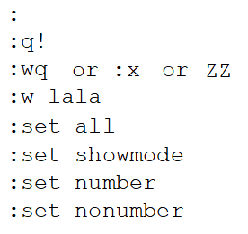
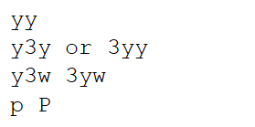
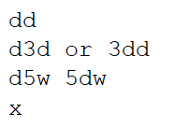
vi/vim Sur-vi-val Skills
Notes:
Ed (line-based) → ex (visual ed with vi being the visual mode, Bill Joy 1976) → vim (Bram Moolenaar 1991)
vim = vi + extras (ext regex, plugins, color language labels, etc.)

Slide 6
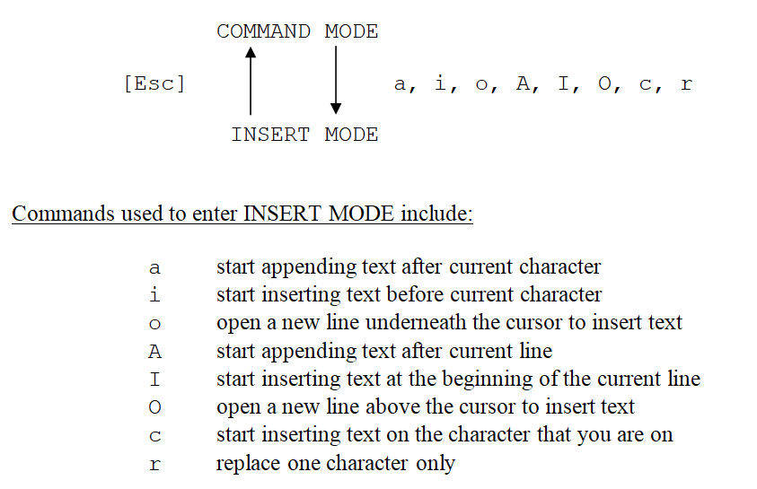
vi/vim Sur-vi-val Skills (expanded)
Notes:
HJKL is for losers

Slide 7
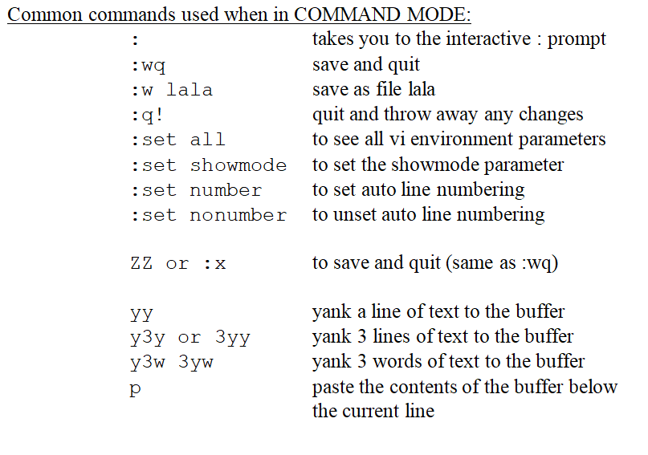
vi/vim Sur-vi-val Skills (expanded)

Slide 8
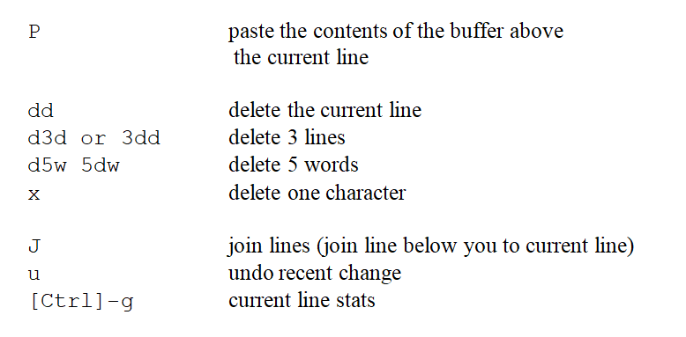
vi/vim Sur-vi-val Skills (expanded)

Slide 9
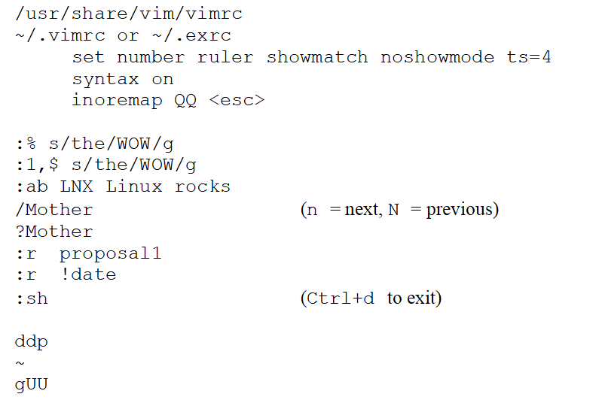
More vi/vim stuff

Slide 10
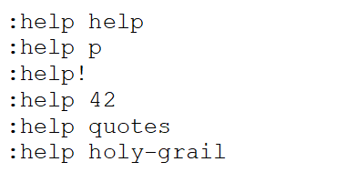
More vi/vim stuff

Slide 11
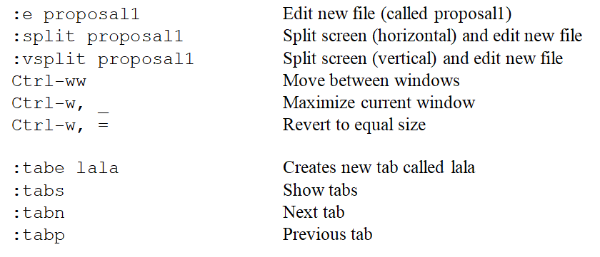
More vi/vim stuff

Slide 12
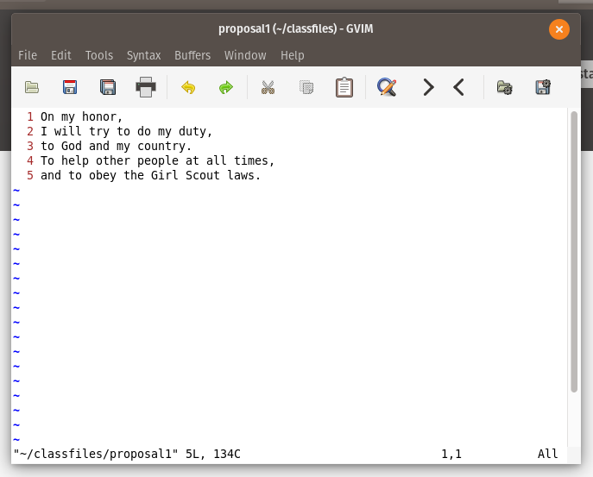
More vi/vim stuff

Slide 13
What are your favourite vi/vim tricks?
PSSH

