Slide 1
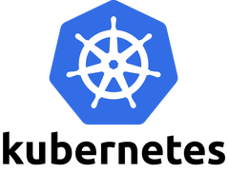
QUICKSTART

Slide 2
Preamble:
This is essentially a follow-on to my previous presentation on cloud buzzwords and how they are related to each other
Microservice development & containers has been standard in development courses/books for years
Containers have been a focus on the sysadmin side for the last few years (and now it’s Kubernetes)
I’ve always approached Kubernetes from the developer side (easy), but I now have to think of how to introduce it on the sysadmin side

Slide 3
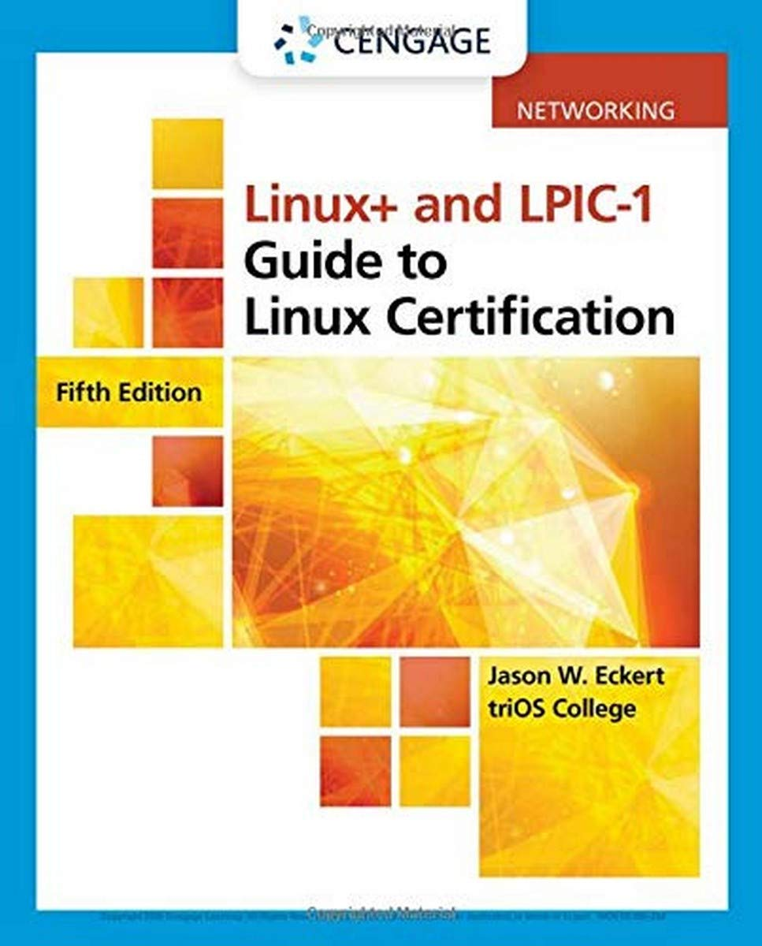
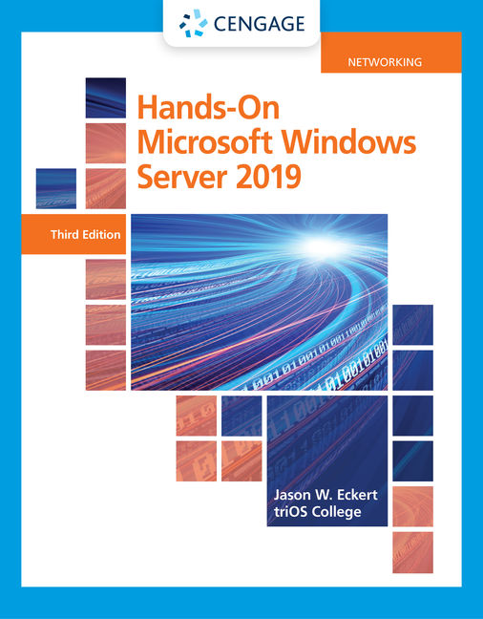
Shameless plug:

Slide 4
Microservices & Kubernetes (K8S)
Want to deploy, scale & manage containers in your public/private cloud?
K8S is the industry standard orchestrator/API
You install a K8S cluster with a control plane and one or more nodes (~VMs with container runtime & kubelet)
Web apps are called pods and may consist of one or more containers or persistent storage volumes.
Managed K8S is common (cloud provider service)

Slide 5
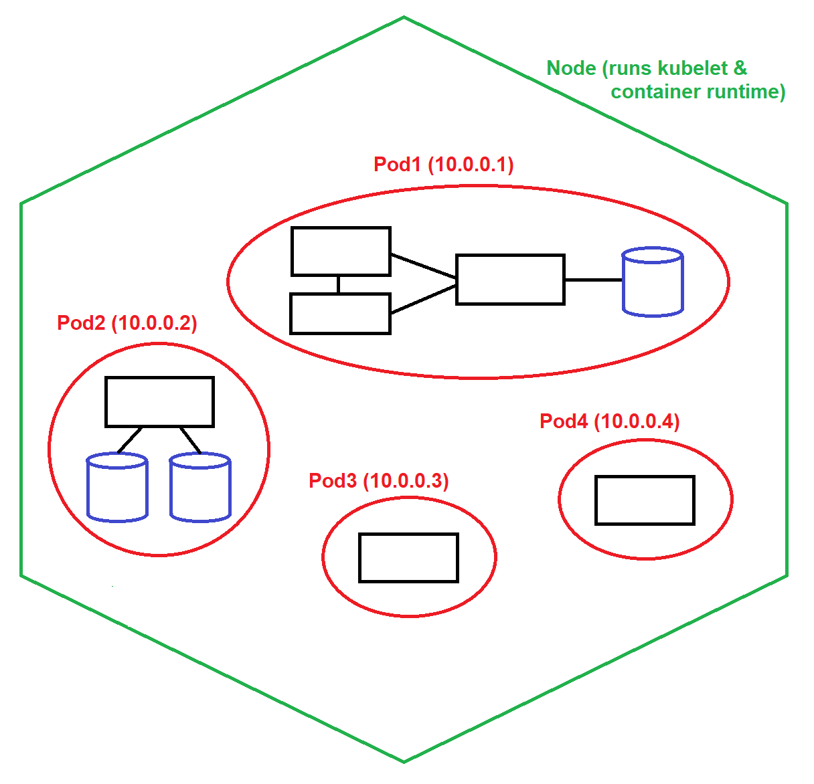

Slide 6
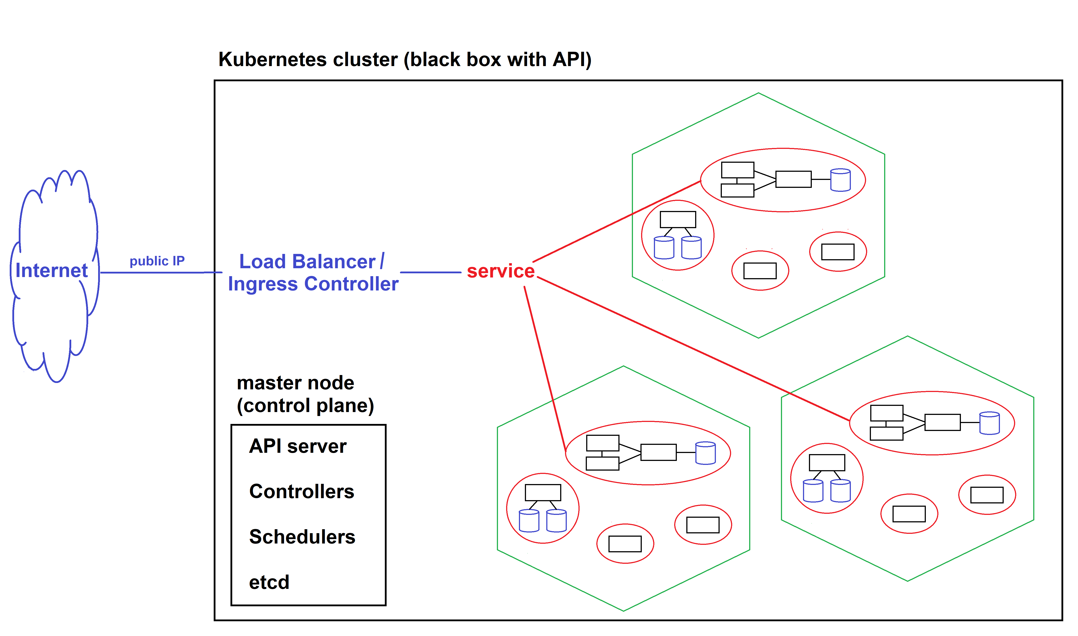

Slide 7
K8S Quickstart Lab Setup
Docker Desktop (includes the containerd runtime) on Windows or macOS
Minikube (a pre-configured single-node Kubernetes cluster that runs in a VM/macOS or WSL2/Windows)
kubectl (the main K8S command – cue-bee-cuttle)
Helm (a package manager for Kubernetes)
Lens (a visual K8S management & monitoring tool)
Prometheus (a K8S data collection tool)
Grafana (displays data from Prometheus)

Slide 8
K8S Quickstart Lab Setup
If you are using Windows, install WSL2:
wsl --install
wsl --set-default-version 2
Install the Docker Desktop app (Windows/macOS) from the Docker website & start it
Containerd runs in background when app is closed
Let’s play with a quickstart (also on my blog)
https://jasoneckert.github.io/myblog/kubernetes-quickstart/

