Slide 1
Introduction to Asahi Linux

Slide 2
Asahi Linux Overview
Native Linux for Apple Silicon (M1)
m1n1/U-Boot + drivers + Arch Linux ARM
Booting other OSes on M1 is supported by Apple
They even added a raw image mode in macOS 12.1+ to prevent updates from breaking 3rd party booting
Must still have macOS installed (dual-boot)
It’s been my dev workstation for over 3 months
Mac Mini M1 (16GB RAM, 500GB SSD)
HDMI output to 34" monitor

Slide 3
Asahi Linux Overview
Safe, stable and easy to remove
Only disables Apple’s SIP (System Integrity Protection) for Linux (macOS still has it enabled)
Developed full-time by Hector Marcan (marcan42)
100% funded by Patreon with many other contributors
Interview with Hector on Twit.tv: https://twit.tv/shows/floss-weekly/episodes/680
How it’s reverse engineered: https://www.youtube.com/watch?v=igYgGH6PnOw

Slide 4
My experience:
🤔 I have to try it out of curiosity (remove later?)
😮 Holy s*it this is fast
Chromium (102) compile took 12 minutes
Hugo composites my site 2x faster than on macOS
LibreOffice just appears magically
🤩 I want to use this
🤩 It runs all the stuff I need
i3-gaps, vim/Kate, Docker + K3S (Java/Postgres/Python)
😊 Arch is actually pretty good!

Slide 5
My experience:
What doesn’t work:
GPU (graphics are CPU-generated with LLVMpipe)
Limited to preferred monitor resolution
Bluetooth, Thunderbolt, HDMI on Macbooks
Sound/mic
Sound driver works, but are waiting for a PipeWire framework & kernel level volume caps (to prevent speakers from blowing!)
I don’t use sound anyways (headphones + phone)
Apps that don’t support the M1’s 16K page size

Slide 6
Installing Asahi
No ISO (run script from macOS)
M1 must use macOS firmware to boot (security)
So, Asahi pretends to be a particular version of macOS with that macOS’s firmware at boot time
This firmware can’t be redistributed, but can be downloaded during install from Apple’s CDN
After install, system boots to Asahi by default
Hold Power button at boot to select Asahi or macOS
Press Alt during selection to make it the default

Slide 7
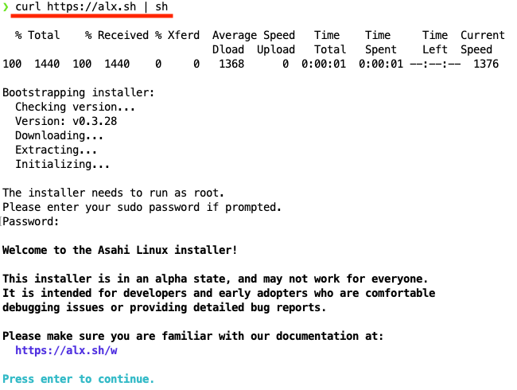

Slide 8
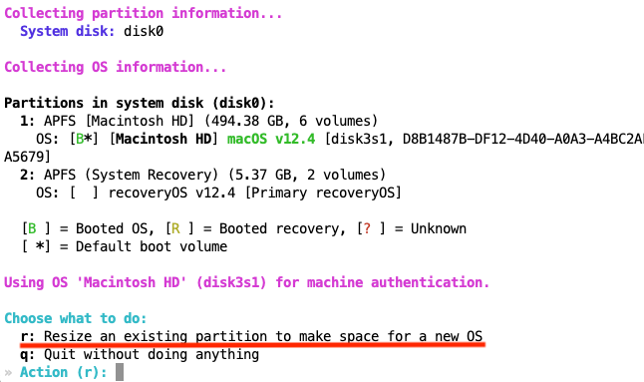

Slide 9
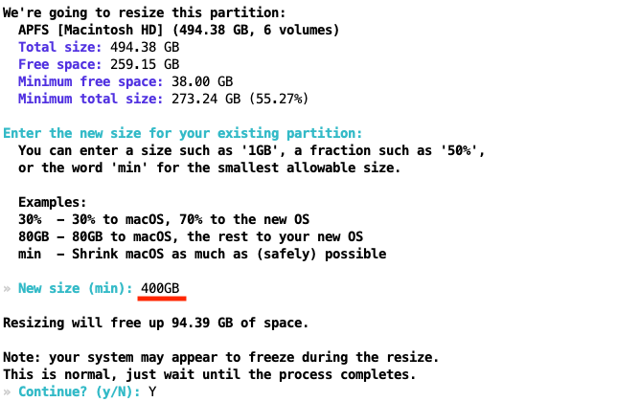

Slide 10
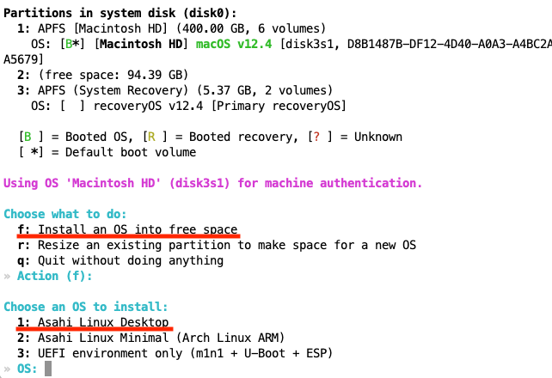

Slide 11
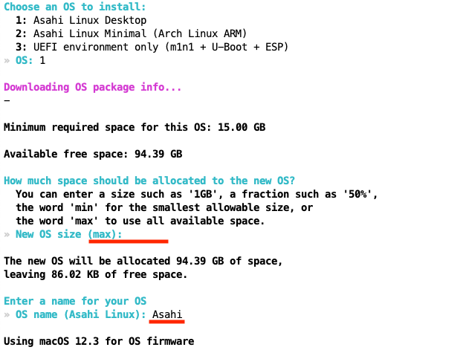

Slide 12
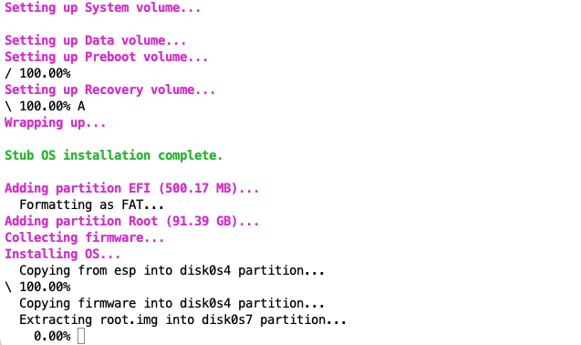

Slide 13
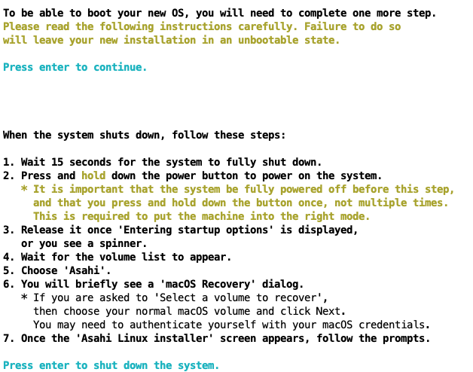

Slide 14
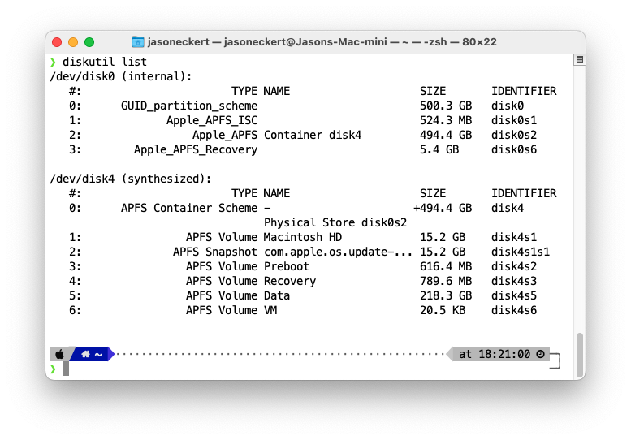

Slide 15
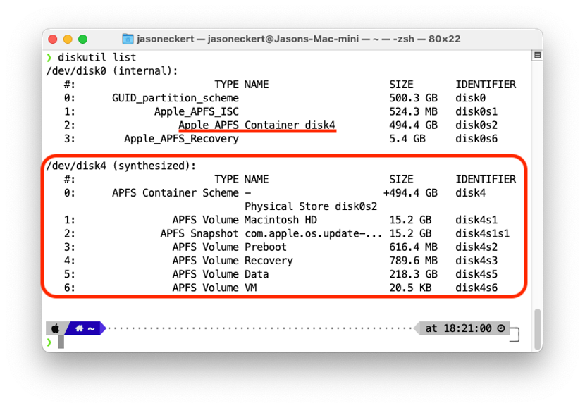

Slide 16
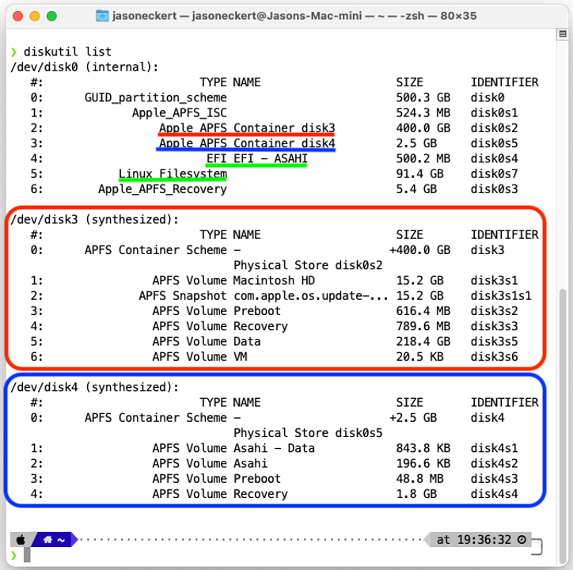

Slide 18
Of course, it’s Linux ;-)
Ran/updated perfectly for 2 months 🥰🥰🥰
Then, one day after updating, X wouldn’t start
Reddit to the rescue:

Slide 19
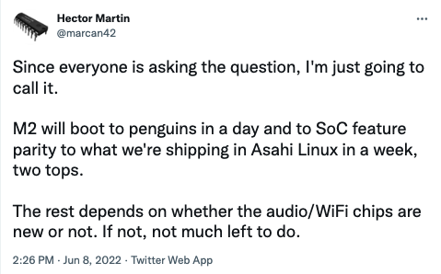
What about M2?

Slide 20
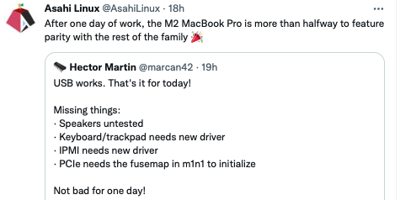
What about M2?

Slide 21
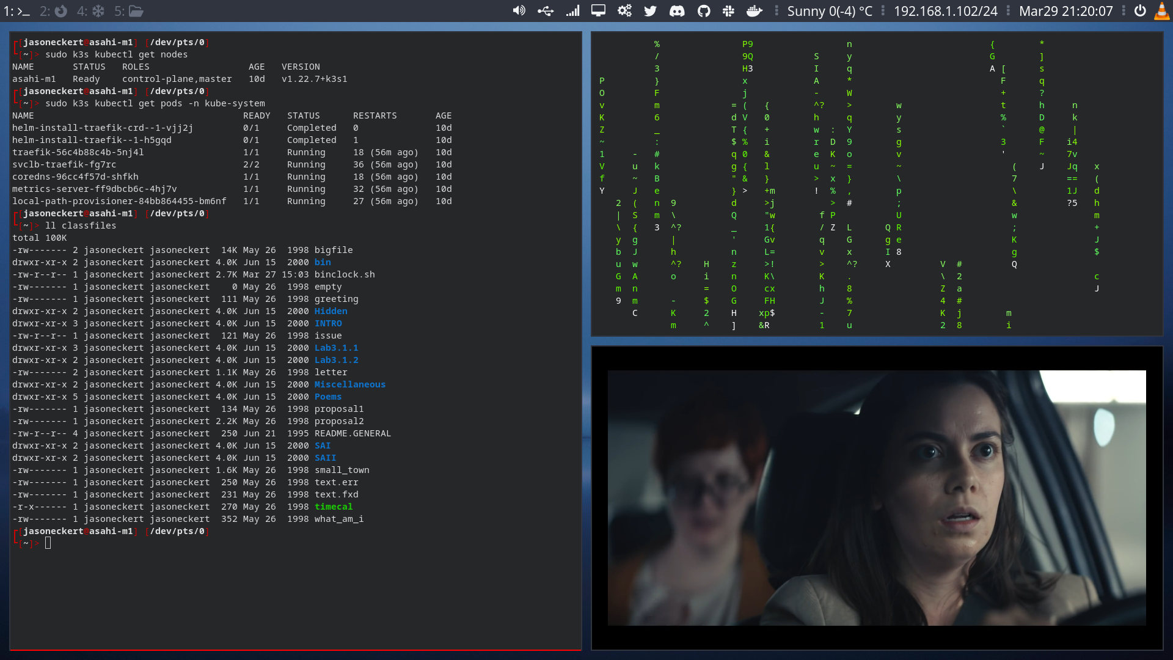
Let’s explore Asahi!

Slide 22
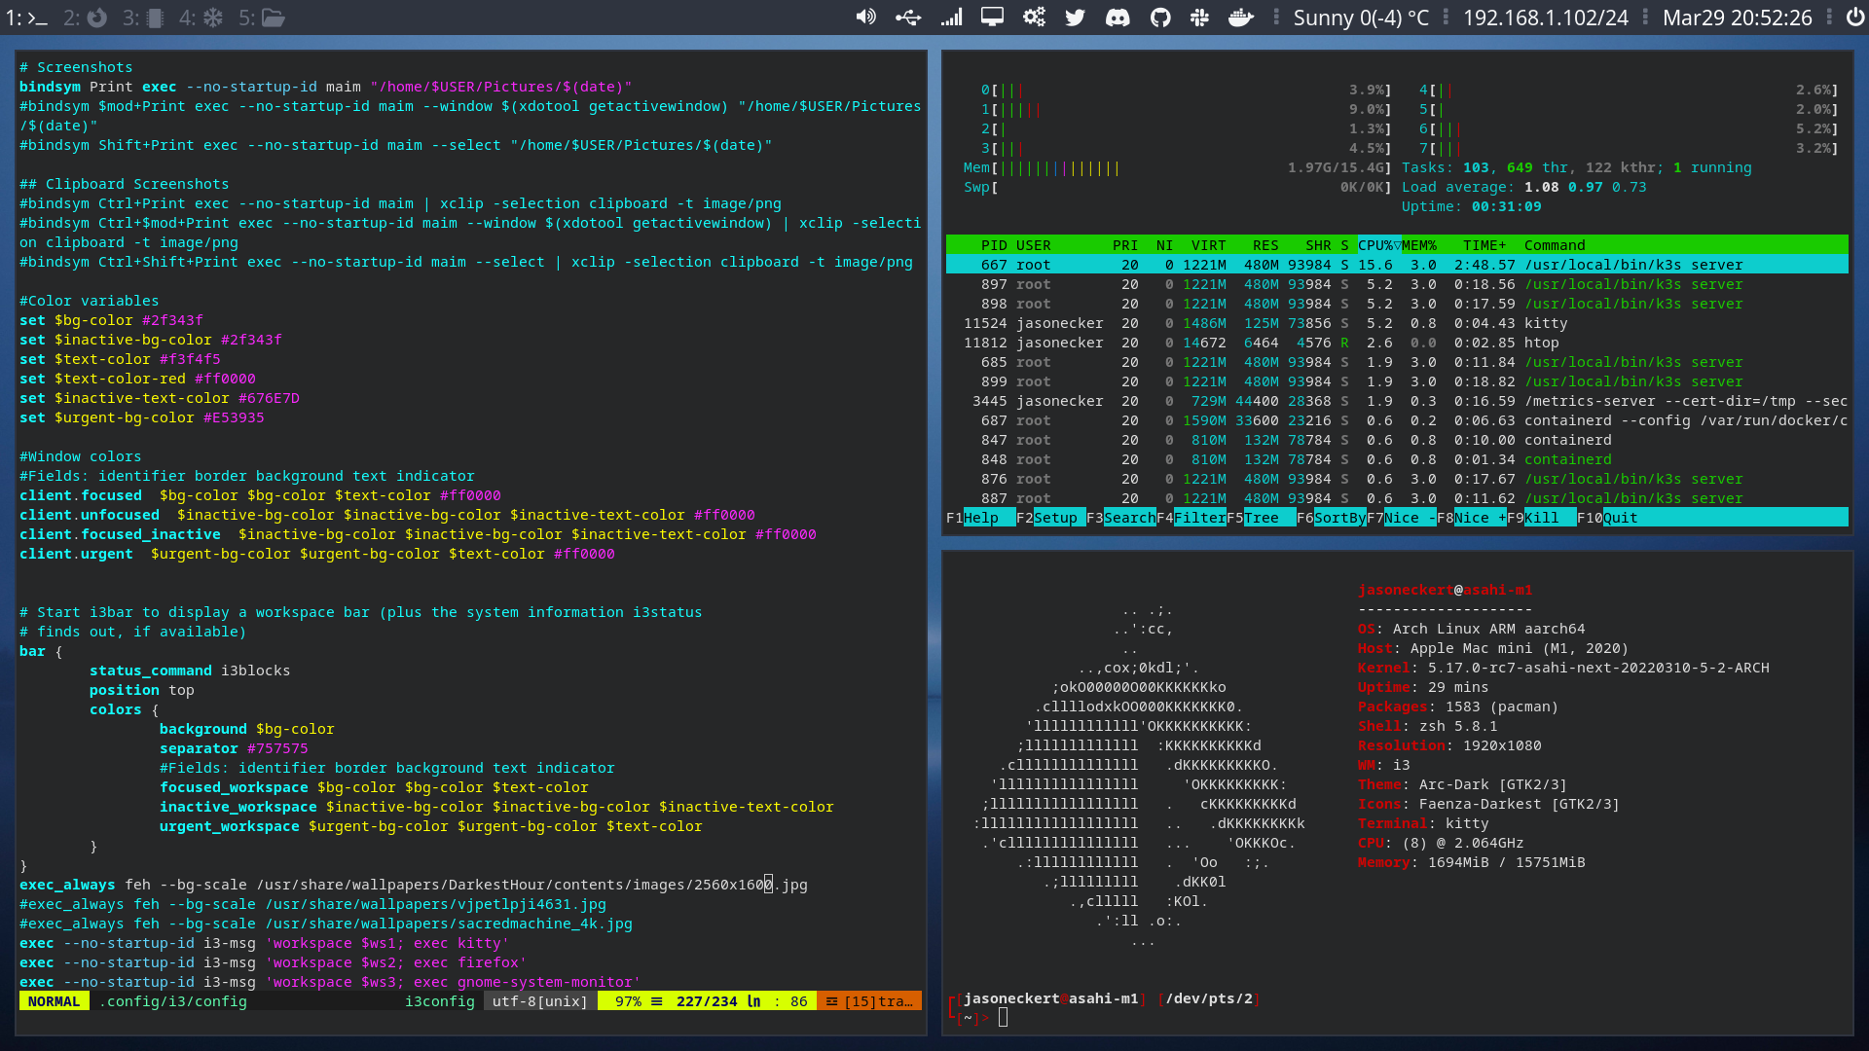
Let’s explore Asahi!

Slide 23
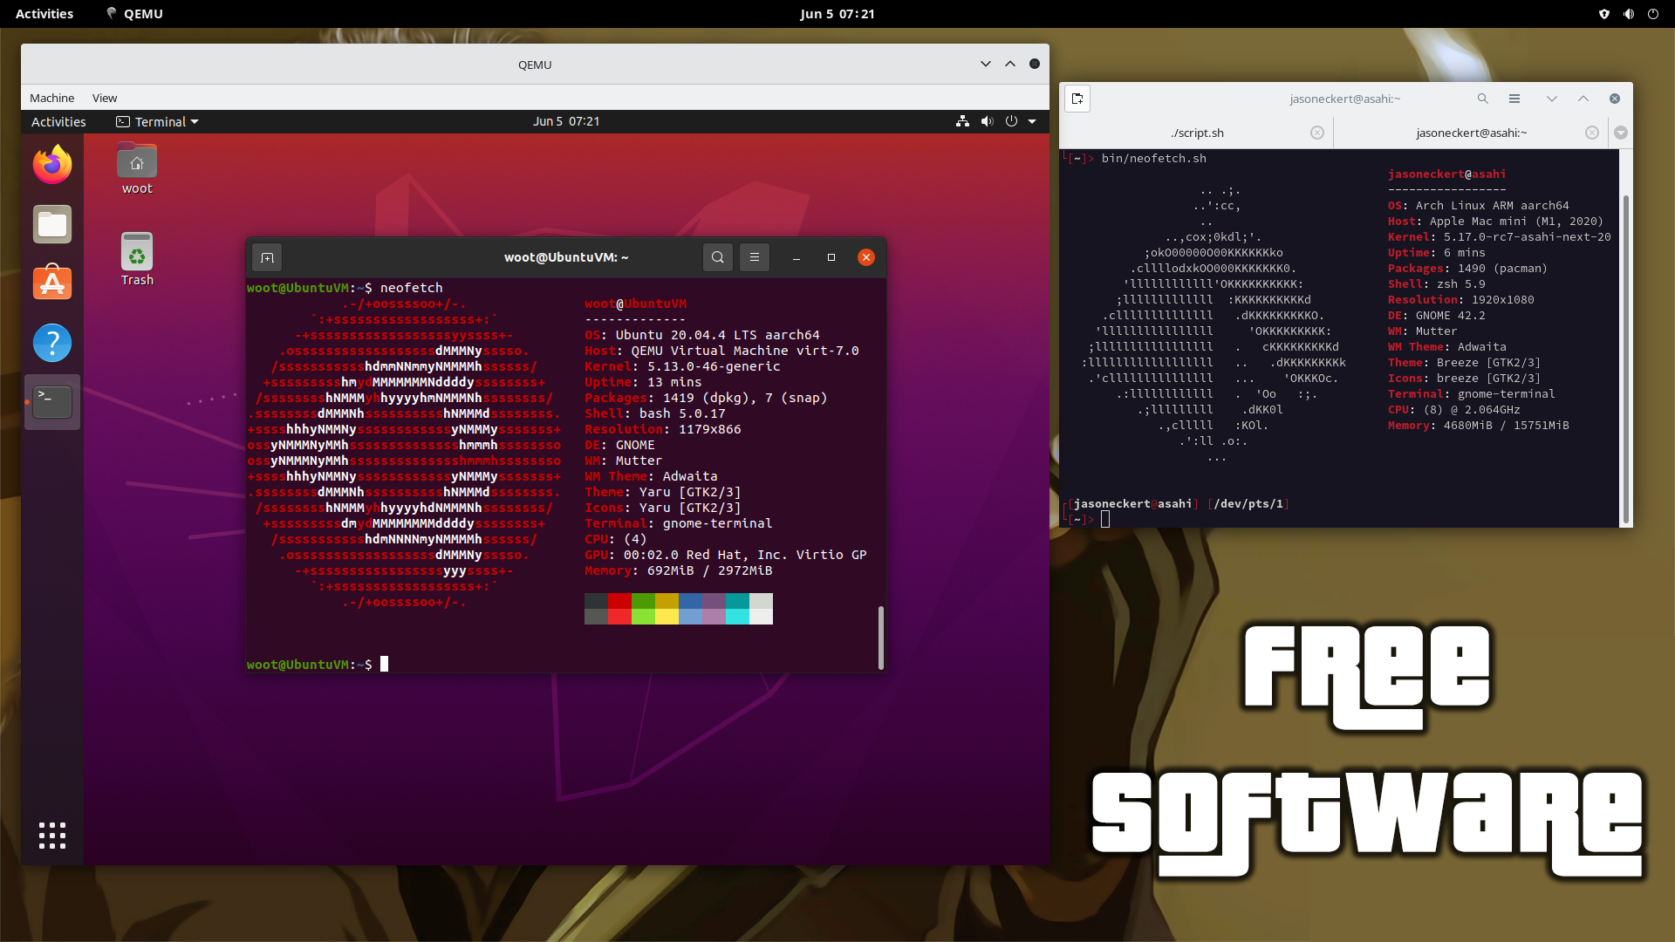
Let’s explore Asahi!

