Slide 1
The UNIX Philosophy in 2023
Jason W. Eckert
jason.eckert@trios.com
jasoneckert.github.io

Slide 2
Wait, isn’t this a Linux User Group?
Today, UNIX is considered a philosophy as well as a group of operating systems that evolved from the original UNIX operating system that share a similar structure and command set

Slide 3
Wait, isn’t this a Linux User Group?
Today, UNIX is considered a philosophy as well as a group of operating systems that evolved from the original UNIX operating system that share a similar structure and command set:
BSD (FreeBSD, NetBSD, OpenBSD)
macOS
Linux

Slide 4
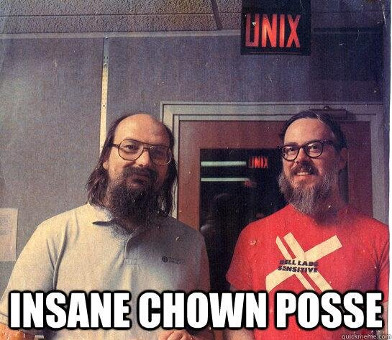
Brief UNIX Background

Slide 5
Brief UNIX Background
Epoch (1969) – the first UNIX
Ken Thompson & Dennis Ritchie (AT&T)
AT&T sold the source to others (Xenix, HP-UX, AIX, IRIX, SCO, Sun Solaris)
Berkeley created BSD (SunOS, NeXTSTEP→macOS, Ultrix, OSF/Tru64, 386BSD, Free/Net/OpenBSD)

Slide 6
Brief UNIX Background
Epoch (1969) – the first UNIX
Ken Thompson & Dennis Ritchie (AT&T)
AT&T sold the source to others (Xenix, HP-UX, AIX, IRIX, SCO, Sun Solaris) = System III/IV/V UNIX
Berkeley created BSD (SunOS, NeXTSTEP→macOS, Ultrix, OSF/Tru64, 386BSD, Free/Net/OpenBSD)

Slide 7
Brief UNIX Background
Epoch (1969) – the first UNIX
Ken Thompson & Dennis Ritchie (AT&T)
AT&T sold the source to others (Xenix, HP-UX, AIX, IRIX, SCO, Sun Solaris) = Sys III/IV/V UNIX
Berkeley created BSD (SunOS, NeXTSTEP→macOS, Ultrix, OSF/Tru64, 386BSD, Free/Net/OpenBSD)
Linux was instead derived from the FSF GNU project (designed to create an open source UNIX)

Slide 8
Brief UNIX Background
Epoch (1969) – the first UNIX
Ken Thompson & Dennis Ritchie (AT&T)
AT&T sold the source to others (Xenix, HP-UX, AIX, IRIX, SCO, Sun Solaris) = Sys III/IV/V UNIX
Berkeley created BSD (SunOS, NeXTSTEP→macOS, Ultrix, OSF/Tru64, 386BSD, Free/Net/OpenBSD)
Linux was instead derived from the FSF GNU project (designed to create an open source UNIX)
Want details? Google “Ultimate UNIX Timeline”

Slide 9
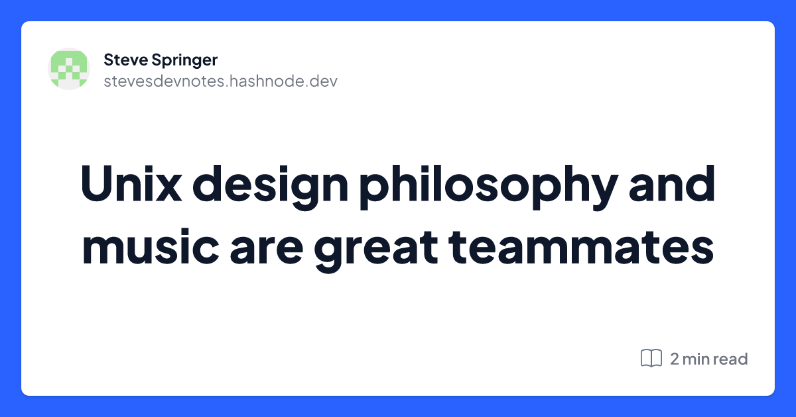
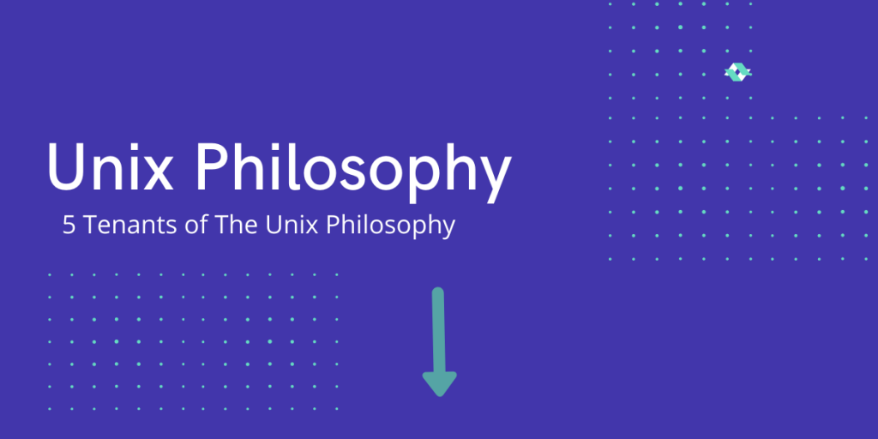
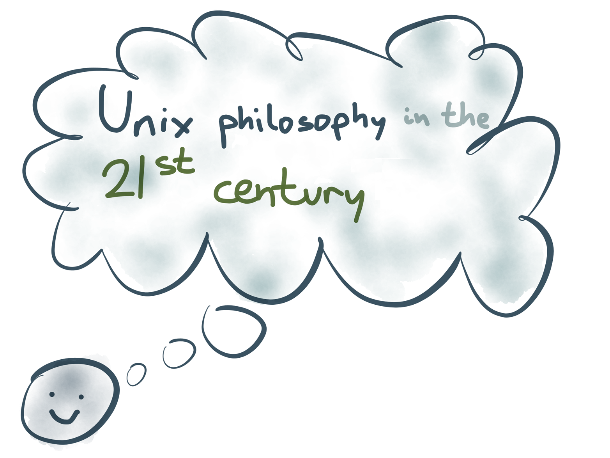
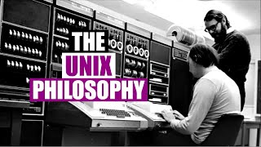
What is the UNIX Philosophy?

Slide 10
What is the UNIX Philosophy?
Most common today:
In simplicity there is power.

Slide 11
What is the UNIX Philosophy?
Most common today:
In simplicity there is power.
curl –L git.io/unix

Slide 12
What is the UNIX Philosophy?
Most common today:
In simplicity there is power.
curl –L git.io/unix
Changed over time, because the virtues of UNIX emerged as it grew:
Simple, portable, and programmer-focused
Focus on networking
Collaborative development

Slide 13
Early UNIX Philosophy
First version by Ken Thompson in 1973:
Write programs that do one thing and do it well
Write programs to work together
Write programs that handle text streams, because that is a universal interface

Slide 14
UNIX Features by 1980
Ritchie and Thompson list the following:
A hierarchical file system incorporating demountable volumes
Compatible file, device, and inter-process I/O
The ability to initiate asynchronous processes
System command language selectable on a per-user basis
Over 100 subsystems including a dozen languages
High degree of portability

Slide 15
1980s UNIX Philosophy
As defined by Brian Kernighan:
Everything is a file
Small, single-purpose programs (modularity)
Ability to chain programs together to perform complex tasks (piping)
Avoid captive user interfaces (most UNIX programs are non-interactive)
Configuration data stored in text

Slide 16
1980s UNIX Philosophy
David Tilbrook on UNIX:
"The one thing that has to be stated about UNIX is that it wasn't a great advance in computing; if anything, it was a great simplification. It put into the realm of the user those things that were just inconceivable prior to that."

Slide 17
1980s UNIX Philosophy
Sun expanded the UNIX philosophy to the network (John Gage, 1984)
The network is the computer (NFS)
Store things once on the network/Internet
Use the network for collaboration

Slide 18
UNIX (late 1980s - early 1990s)
When AT&T bought a chunk of Sun in 1987 and announced that Sun OS 5 would be SysV, it shook up the UNIX world:
DEC, IBM, etc. formed OSF and OSF/1
Sun/AT&T formed UNIX International group
Then came Linux (open source UNIX) and the 386BSD legal battle (led to Free/NetBSD)
UNIX’s future = open source?
Linux is UNIX’s future?

Slide 19
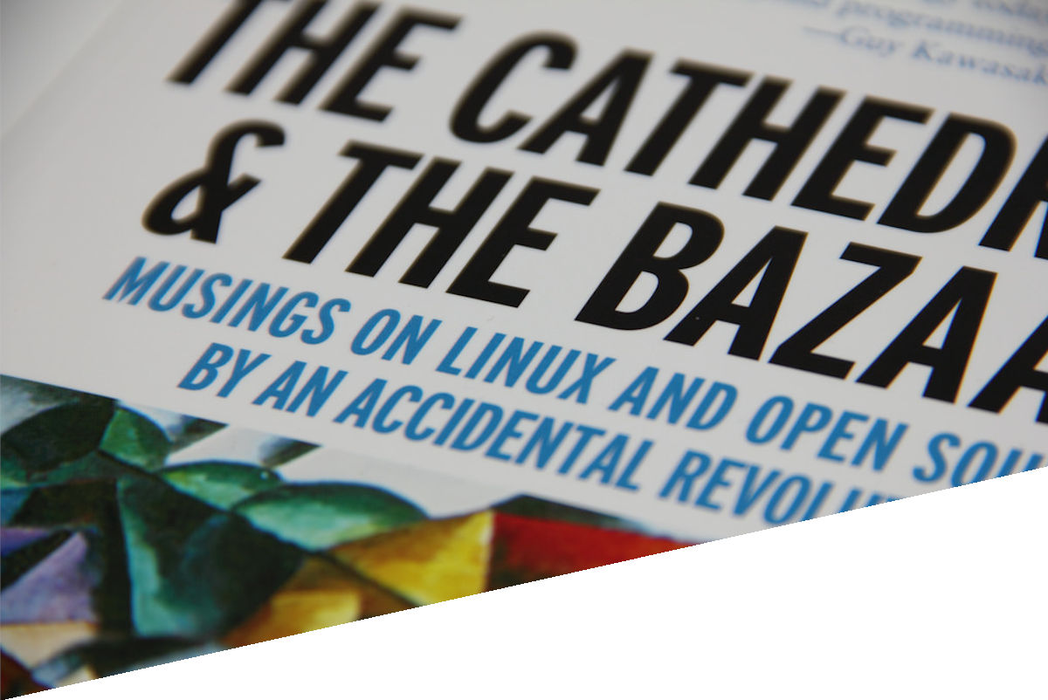
1990s UNIX Philosophy

Slide 20
1990s UNIX Philosophy
Eric S. Raymond (ESR) expanded it to reflect the focus on open source development:
Modularity: Write simple parts connected by clean interfaces (no complex, unreadable code)
Clarity: Clarity is better than cleverness (others must work on the code)
Composition: Design smaller programs that can be connected with other programs (avoid complex monolithic programs)

Slide 21
1990s UNIX Philosophy
Separation: Let policies be changed without destabilizing mechanisms (consequently reducing the number of bugs)
Simplicity: Design for simplicity; add complexity only when you must
Transparency: Design for visibility to make inspection and debugging easier
Failure: When you must fail, fail noisily and ASAP

Slide 22
1990s UNIX Philosophy
Diversity: Distrust all claims for “one true way”
Extensibility: Design for the future, because it will be here sooner than you think
Parsimony: Write small, easily-replaceable code that can be thrown away if needed. Don't be afraid to throw away large chunks of code if it sucks.

Slide 23
Early 2000s

Slide 24
Early 2000s
UNIX philosophy was widely regarded as an outdated guideline (although ESR’s points were key to projects)
This was due to perception at the time:
It doesn't scale well
Monolithic can be good for some things
Security and UI needs don’t fit well into it
Microsoft & FUD contributed to this!

Slide 25
By the Mid-2010s
Linux and open source rules the world/cloud
Open source & UNIX philosophy widely regarded as compulsory (education too!)
Building small, focused applications collaboratively in a cloud and microservices environment
Network (HTTP) APIs, YAML/JSON config, XML, etc.
Revisiting the Unix philosophy in 2018 (Red Hat blog, Michael Hausenblas)

Slide 26
Where are we today?
UNIX philosophy is widely known and ‘quoted’
Focus is on smaller, simpler, reusable components
Text is still king
Everything is stored on the network (cloud)
Open source rules the world (many licenses, formal processes/norms)

Slide 27
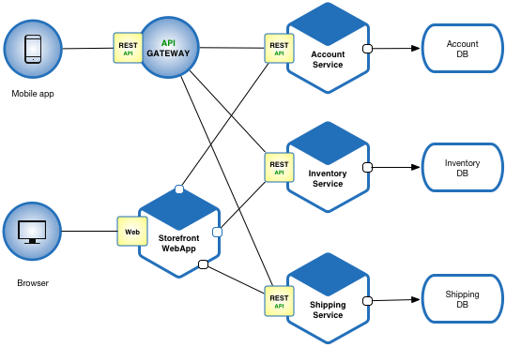
Where are we today?
UNIX philosophy is widely known and ‘quoted’
Focus is on smaller, simpler, reusable components
Text is still king
Everything is stored on the network (cloud)
Open source rules the world (many licenses, formal processes/norms)

Slide 28
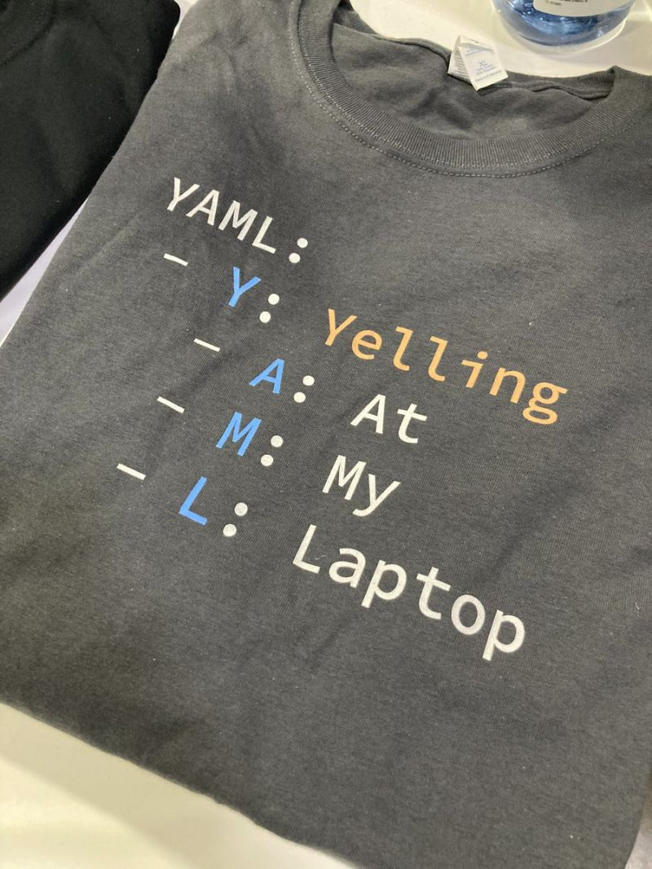
Where are we today?
UNIX philosophy is widely known and ‘quoted’
Focus is on smaller, simpler, reusable components
Text is still king
Everything is stored on the network (cloud)
Open source rules the world (many licenses, formal processes/norms)

Slide 29
Where are we today?
UNIX philosophy is widely known and ‘quoted’
Focus is on smaller, simpler, reusable components
Text is still king
Everything is stored on the network (cloud)
Open source rules the world (many licenses, formal processes/norms)

Slide 30
Where are we today?
UNIX philosophy is widely known and ‘quoted’
Focus is on smaller, simpler, reusable components
Text is still king
Everything is stored on the network (cloud)
Open source rules the world (many licenses, formal processes/norms)

Slide 31
Where are we today?
LPI did a more modern take on how pervasive open source development has become – search YouTube for:
The future’s hiring Linux Professional Institute

Slide 32
Where are we today?
Today’s UNIX philosophy hasn’t hasn’t strayed too far from Ken Thompson’s original definition in 1973:
We write programs that do one thing and do it well
We write programs to work together
And we write programs that handle text streams, because that is a universal interface
We’ve since emphasized simplicity and added the network and open source dimensions only

